Slide 1

Energy Quiz
Sponsored by
Efficiency Services Group

Slide 2
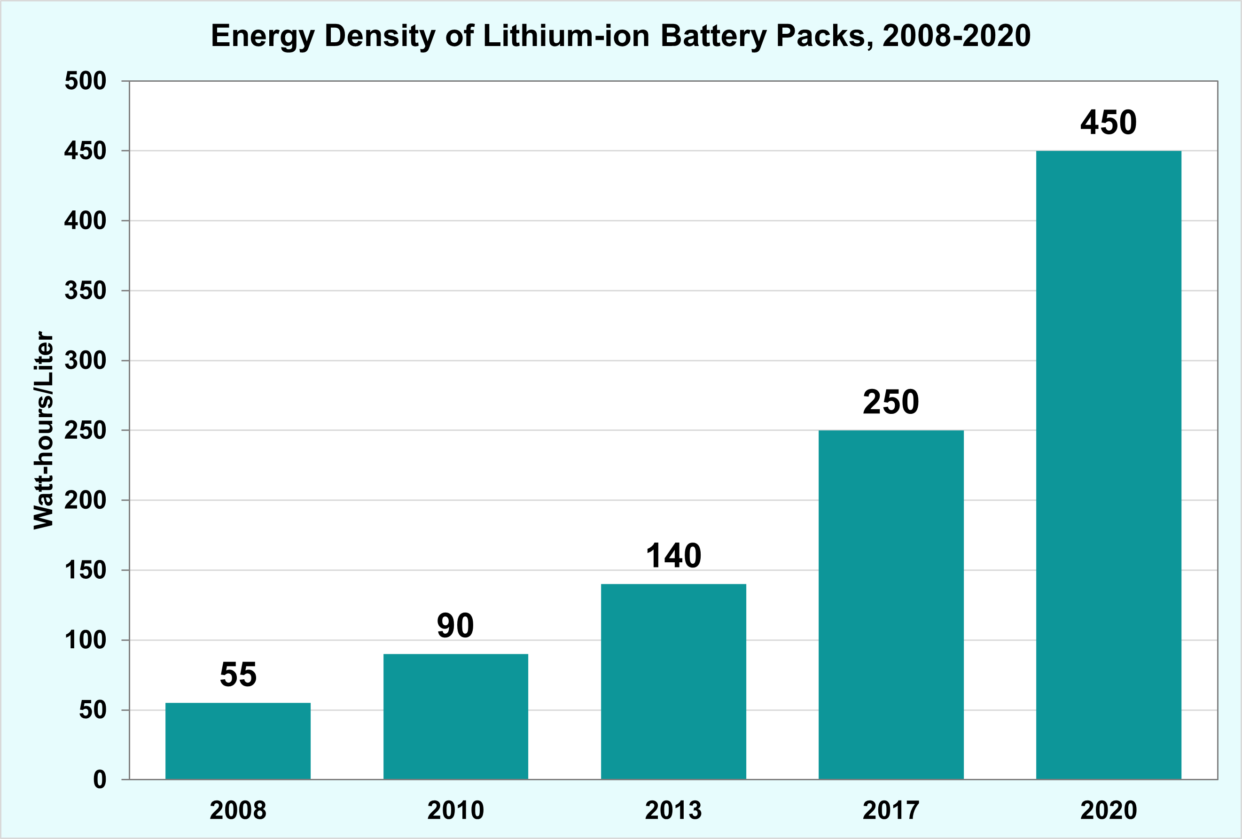

In the last ten years, EV range has tripled. This is due in great part to an increase in EV battery efficiency of:
32%
54%
67%
82%

Slide 3
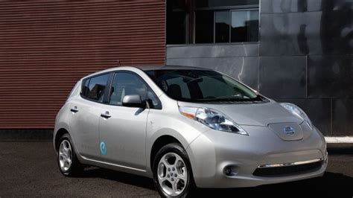
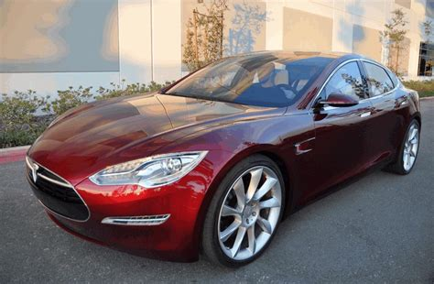
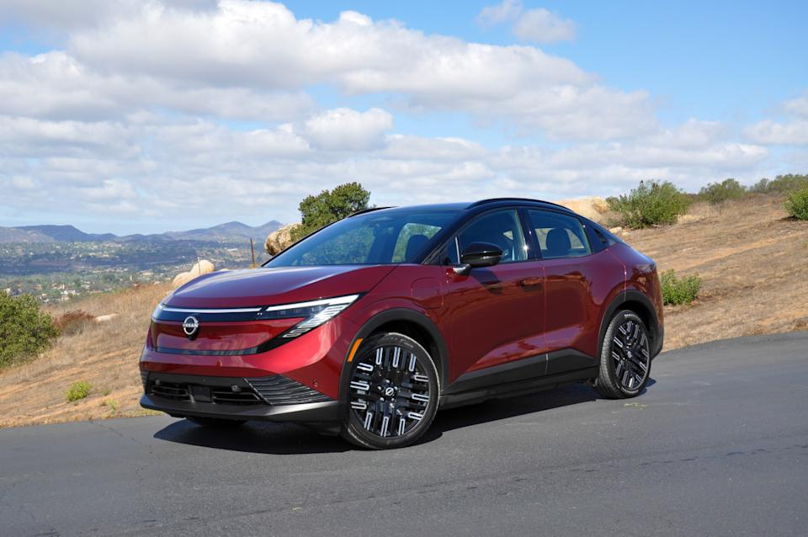
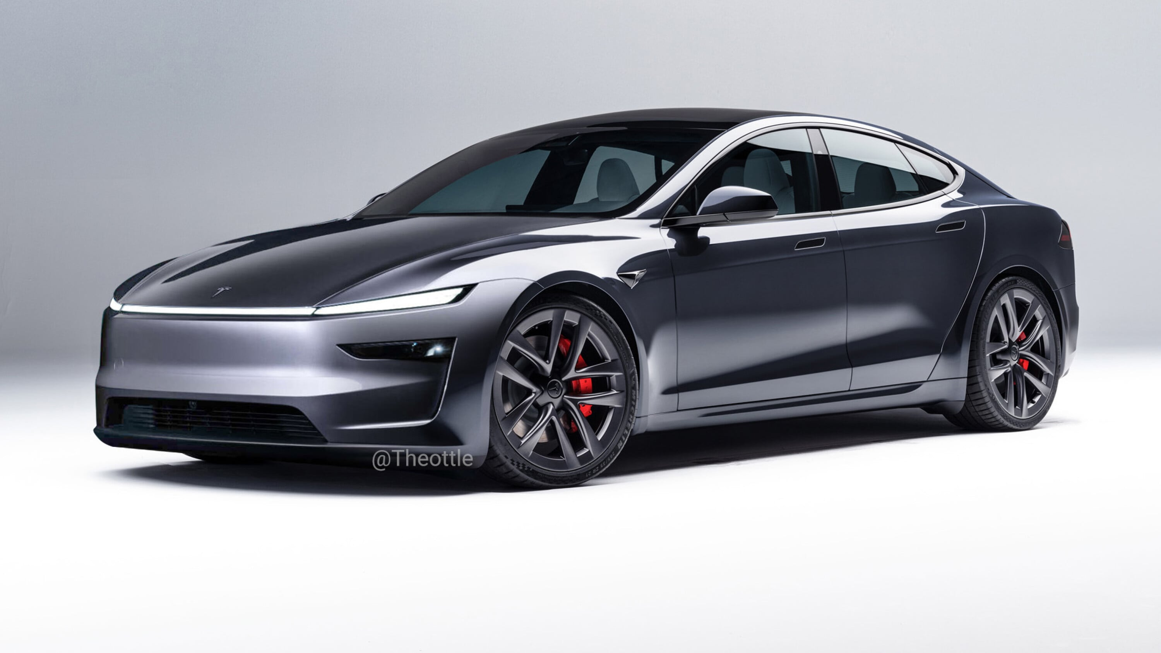
Electric vehicle sales in the U.S. in 2011 was 0.14%.
2025 was the second highest year for EV sales in the U.S. coming in at:
Nissan Leaf
Tesla Model S
2011
2011
7.8%
9.1%
11.6%
14.2%
2026
2026

Slide 4
Energy Quiz
Sponsored by
Efficiency Services Group

Slide 5

The national average cost per kWh increased 40% between 2005 and 2015. How much did the average cost per kWh increase between 2015 – 2025?
28.6%
36.4%
43.4%
51.6%
2005 $0.10/kWh
2015 $0.14/kWh
2025 $0.18/kWh

Slide 6


Which state has the most data centers?
Texas
California
Virginia
Ohio
These four states represent 41% of the data centers in the US. (Source: Aterio)

Slide 7
Energy Quiz
Sponsored by
Efficiency Services Group

Slide 8
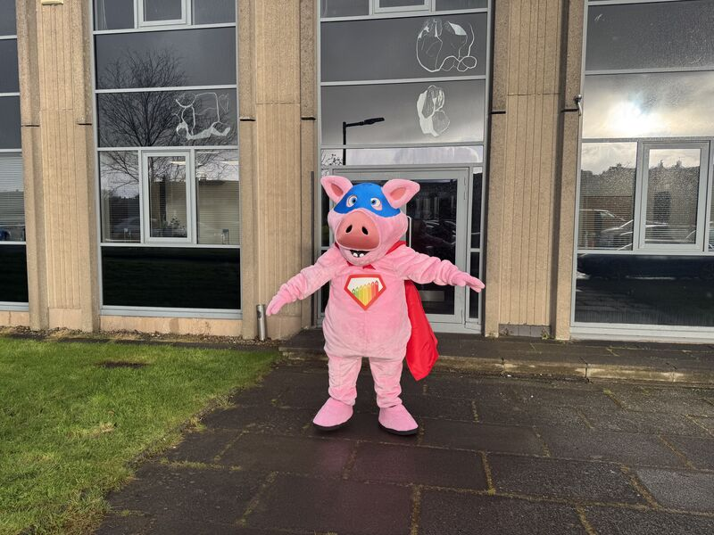
Which country has the highest energy use per capita?
Iceland
United Arab Emirates
United States
China
Source: World Bank
Iceland uses approximately 4 times more power per capita over the United States.

Slide 9
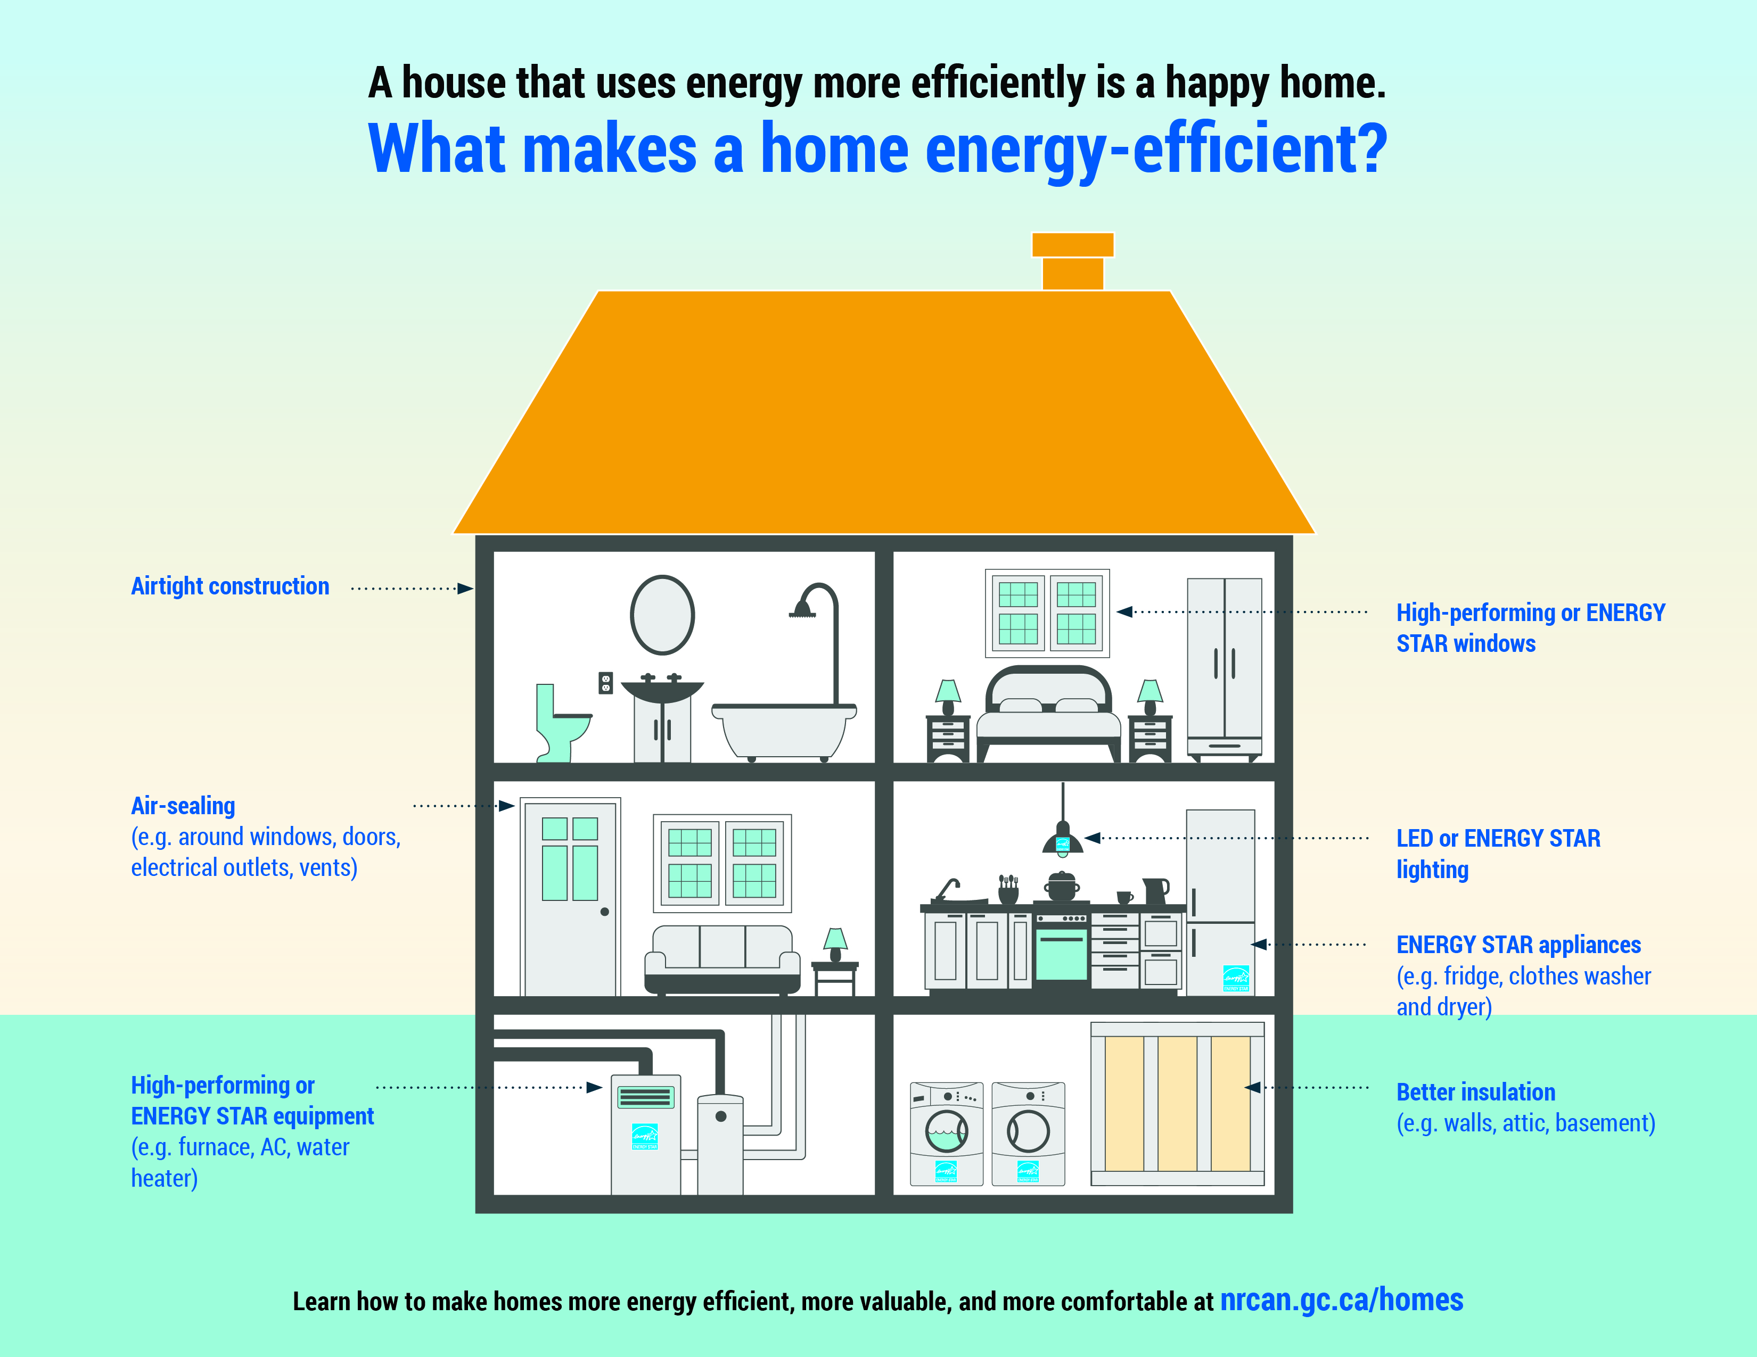


Which country was the first to enact energy efficiency standards?
Germany
United States
Australia
Denmark
The Energy Policy and Conservation Act (EPCA) was enacted in 1975

Slide 10
Energy Quiz
Sponsored by
Efficiency Services Group

Slide 11

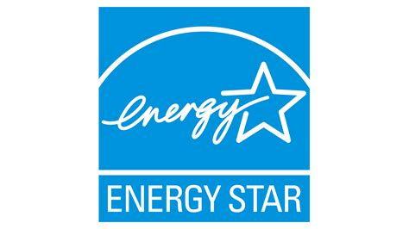
The U.S. Environmental Protection Agency (EPA) launched the ENERGY STAR® program in 1992. According to the EPA, how many kWh has the ENERGY STAR program saved since its inception?
980 Billion
1.8 Trillion
3.6 Trillion
5 Trillion
Context: The U.S. consumed 4.086 trillion kWh of electricity in 2024. (Source: Solar Tech)

Slide 12
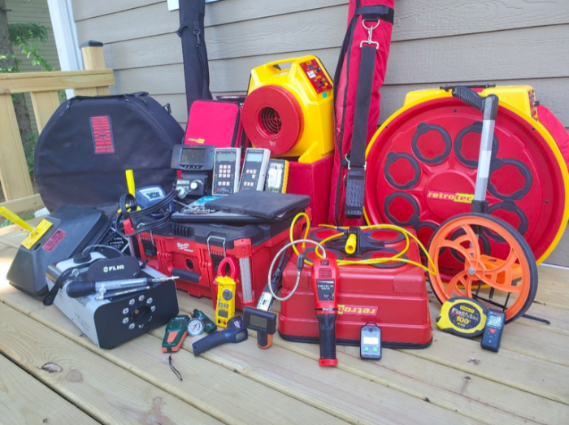

What was the origin of the “Home Energy Audit”?
Edison Electric Institute created energy audits as a nationwide Energy Efficiency Program in 1975.
Federal Government forced utilities to provide this service to their customers
Partnership between insulation manufacturers and electric utilities
Created in partnership between General Electric and Edison Electric Institute to promote modern appliances in the 1960s

Slide 13
Energy Quiz
Sponsored by
Efficiency Services Group

Slide 14
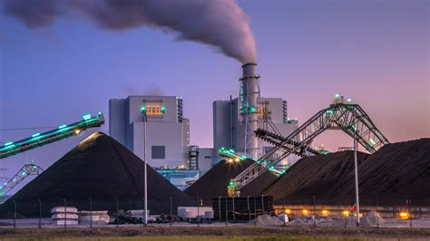
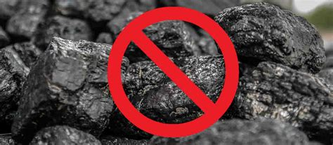
Which was the first formerly coal-burning country to go coal free?
United Kingdom
Ireland
Belgium
France

Slide 15

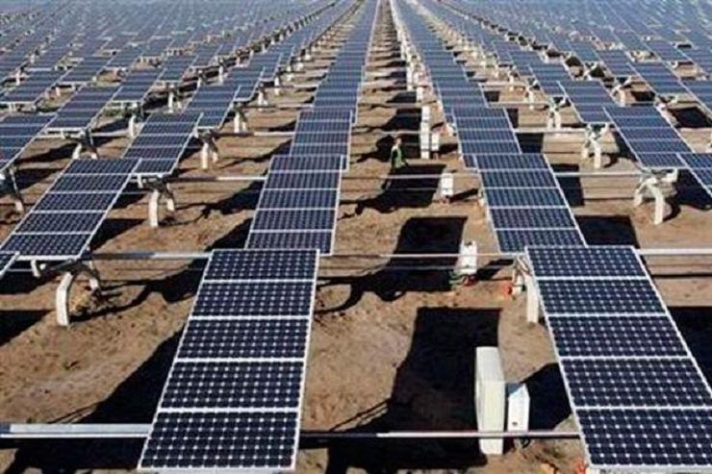

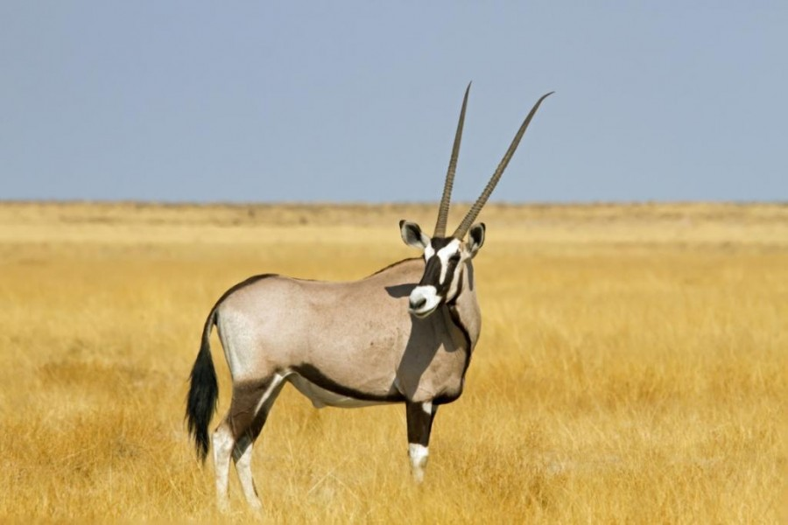

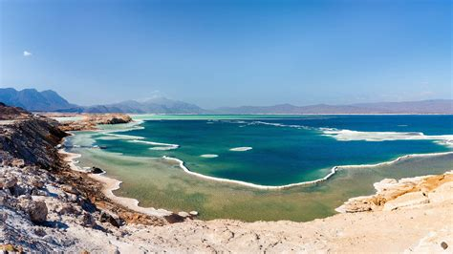
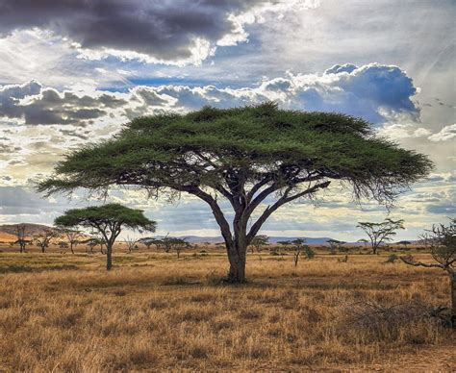

Which African country has over 67% (two thirds) of its power coming from renewable resources?
Burkina Faso
Djibouti
Gabon
Togo
Flag
National Animal:
East African Oryx
National Instrument:
Tanbura
National Tree:
Acacia Tortilis

Slide 16
Energy Quiz
Sponsored by
Efficiency Services Group

